Slide 1
Apple is the Best

Slide 2

Why Apple is the Best Choice for All Your Tech Needs
Introduction question
Purpose of the presentation

Slide 3
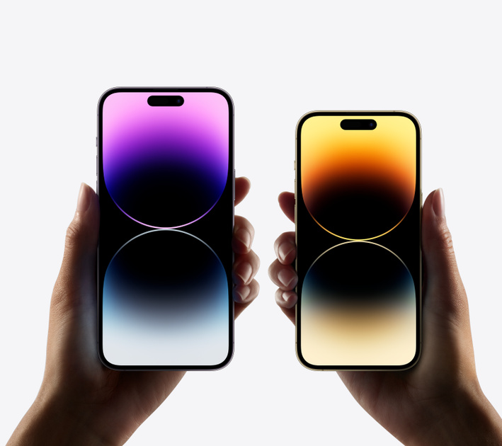
Form and Function
Form and Function combination of Apple products
Key points:
Aesthetically pleasing design
Reliable, durable, and high-performing
Suitable for students, professionals, and those looking to stay connected

Slide 4
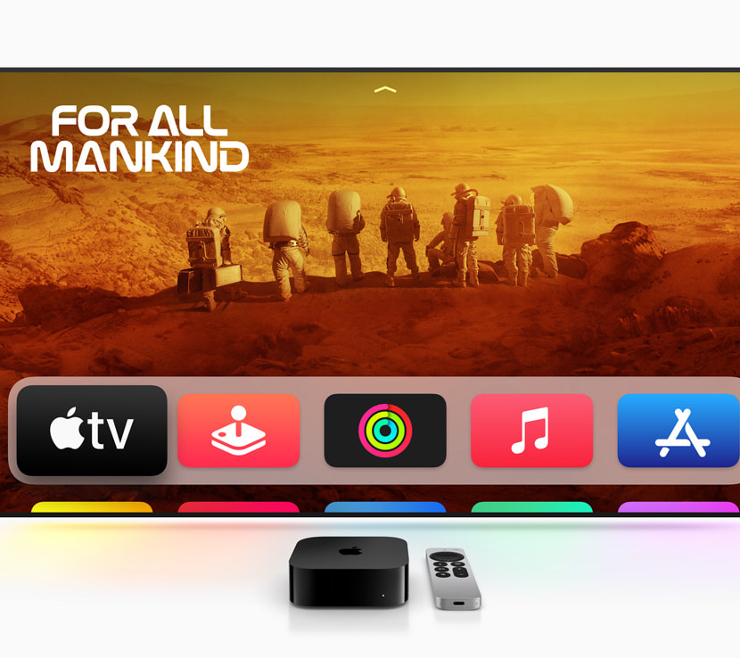
User Experience
Prioritizing User Experience
Key points:
Easy-to-use interface and operating system
Enjoy the benefits of the latest technology without feeling overwhelmed
Suitable for all age groups and tech expertise levels

Slide 5

Customer Service and Support
Excellent customer service and support
Key points:
Online chat and in-store support available
Free workshops for learning how to get the most out of your device
High-quality customer service that is unmatched by other tech companies

Slide 6

Conclusion
Experience provided by Apple
Key points:
Focus on design, function, user experience, and customer support
Join millions of satisfied customers and upgrade to Apple today
Don't wait any longer and take advantage of all the amazing benefits that Apple has to offer

Slide 7

Thank You

